Slide 1
Shopping Behavior & Purchase Patterns
Understanding customer spending, discounts, and purchasing behavior across demographics

Slide 2
Business Objective
Identify key customer segments driving purchases
01
Understand spending behavior and discount usage
02
Evaluate purchase frequency and subscription behavior
03
Surface patterns by age, gender, location, and season
04

Slide 3

Data Overview
~3,900 customers / purchases
Customer demographics (age, gender, location)
Purchase attributes (items, colors, seasons)
Discount and subscription indicators
Review ratings and spend amounts

Slide 4
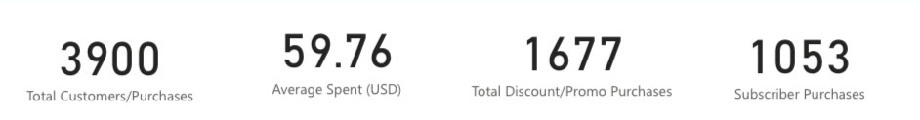
Key Performance Indicators
This immediately tells us how much value is driven by discounts and subscribers

Slide 5
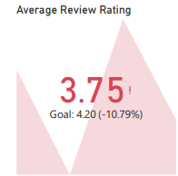
Customer Satisfaction Signal
Current average rating: 3.75
Target: 4.20
Performance is ~11% below target
Why it matters:
Lower ratings may explain churn or reduced repeat purchases
Highlights experience improvement opportunity

Slide 6
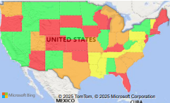
Geographic Spend Distribution
Green = strong performance
Yellow/Orange = moderate
Red = underperforming states
Spending performance varies significantly by state, suggesting region-specific marketing or logistics effects

Slide 7
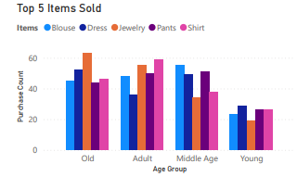
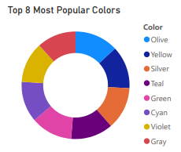
Product Preferences
Clothing dominates purchases
Age groups show different item preferences
The most popular colors range in olive, yellow, silver, teal, green, cyan, violet, and gray

Slide 8
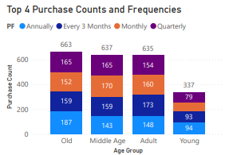
Purchase Frequency & Timing
Older and middle-age groups purchase more frequently
Younger customers show lower repeat behavior
Quarterly and annual purchases dominate
Why this matters:
“Different age groups respond to different cadence strategies.

Slide 9
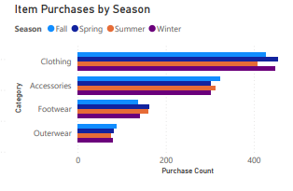
Seasonality Patterns
Fall and Spring drive the highest volume
Clothing and accessories lead across all seasons
Outerwear spikes seasonally as expected

Slide 10
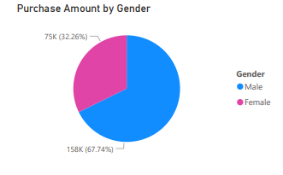
Demographic Spend Split
Majority of spend driven by male customers
Important for messaging, product assortment, and promotions

Slide 11

Key Insights Summary
Spending is concentrated among specific age groups and regions
Discounts play a large role but don’t dominate all segments
Subscribers represent a meaningful revenue base
Customer satisfaction is below target and may limit growth
Seasonal and demographic patterns present targeting opportunities

Slide 12

Recommendations
Focus discounts on customers who shop often.
Make the shopping experience better to get higher reviews.
Use local trends to create region-specific promotions.
Offer stronger perks for customers who subscribe or buy regularly.
Plan stock based on seasonal shopping patterns.

